Slide 1
Stacks

Slide 2
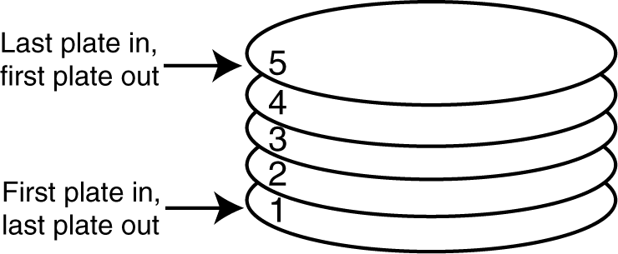
Introduction to Stacks
A stack is a data structure that stores and retrieves items in a last-in-first-out (LIFO) manner.
The last item placed on the stack will be the first item removed
Analogy
A stack of dishes in a cafeteria

Slide 3
Stacks
A Stack is a linear data structure in which addition or
deletion of elements takes place at the same end.
This end is often called as top of stack.
[Restricted form of list: Insert and remove only at front of list.]
Notation:
Insert: PUSH
Remove: POP
The accessible element is called TOP.

Slide 4
Static and Dynamic Stacks
Static Stacks
Fixed size
Can be implemented with an array
Dynamic Stacks
Grow in size as needed
Can be implemented with a linked list

Slide 5
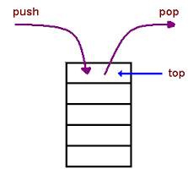
Stack Operations
Push
causes a value to be stored in (pushed onto) the stack : push(data_type value)
Pop
retrieves and removes a value from the stack: pop()

Slide 6
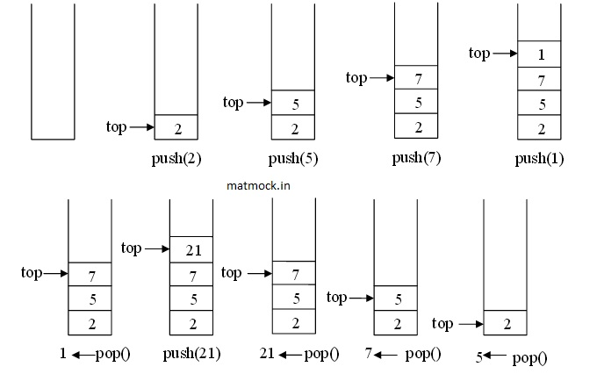
Push & Pop Operations

Slide 7
Other Stack Operations
initialize():
Initialize the stack to be empty.
isFull():
Determine if stack is full or not. A Boolean operation needed for static stacks. Returns true if the stack is full. Otherwise, returns false.
isEmpty():
Determine whether stack is empty or not. A Boolean operation needed for all stacks. Returns true if the stack is empty. Otherwise, returns false.
display():
If the stack is not empty then retrieve all the element starting at its top.

Slide 8
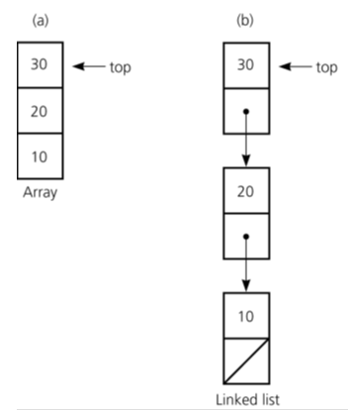
Stack Implementations
Two implementations:
Array-based
Linked list

Slide 9
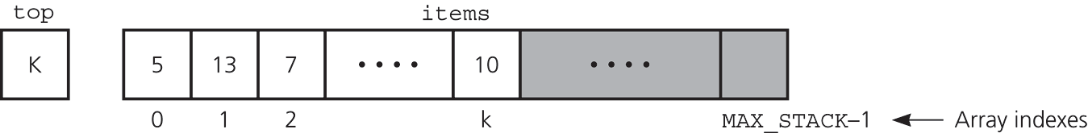
Array-based Stacks
Stacks can be represented in memory using arrays.
We can declare an array named as STACK.
We also use TOP variable to represent top most element of stack.
Finally a variable MAX_STACK, which gives maximum number of elements that can be stored in stack.
An array-based implementation

Slide 10
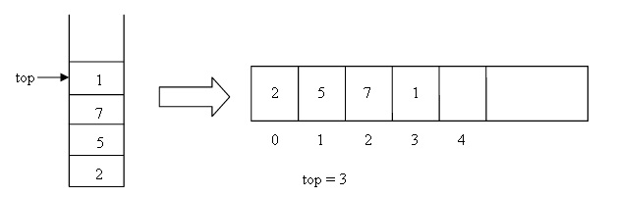
Array-based Stacks
Top is pointing to index number 03, which means stack has four items.
Sometimes when a new data is to be inserted into stack but there is no available space, this situation is called as stack overflow.
Sometimes when a data is to be removed/deleted from stack but there is no available data, this situation is called as stack underflow.

Slide 11
Implementation of Operations
bool isEmpty(){
return (top < 0);
}
void push(data_type newItem){
// if stack has no more room for
// another item
if (top >= MAX_STACK-1)
cout<<“Stack Overflow!”;
else{
++top;
items[top] = newItem;
cout<<“Item inserted at the top”;
}
}

Slide 12
Implementation of Operations
data_type pop(){
if (isEmpty())
cout<<“Stack underflow”;
// stack is not empty retrieve top
else {
stackTop = items[top];
--top;
return stackTop;
}
}

Slide 13
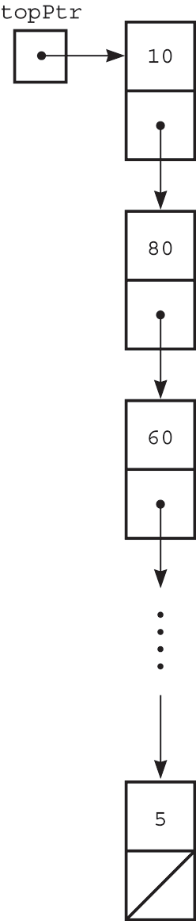
Linked list Implementation
A pointer-based implementation
Required when the stack needs to grow and shrink dynamically
top is a reference to the head of a linked list of items

Slide 14
Linked list Implementation: Operations
bool isEmpty(){
return (topPtr == NULL);
}
void push(dataType newItem) {
// create a new node
StackNode *newPtr = new StackNode;
// set data portion of new node
newPtr->item = newItem;
// insert the new node
newPtr->next = topPtr;
topPtr = newPtr;
}

Slide 15
Linked list Implementation: Operations …
dataType pop() {
if (isEmpty())
cout<<“Stack is empty…!”;
// not empty; retrieve and delete top
else{
stackTOp = topPtr->item;
StackNode *temp = topPtr;
topPtr = topPtr->next;
// return deleted node to system
temp->next = NULL; // safeguard
delete temp;
return stackTOp;
}
}

Slide 16
Comparing Implementations
An array-based implementation
Prevents the push operation from adding an item to the stack if the stack’s size limit has been reached
A pointer-based implementation
Does not put a limit on the size of the stack

Slide 17
Applications of Stacks

Slide 18
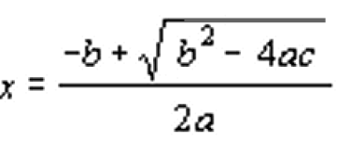
Evaluation of Algebraic Expressions
4+5*5
Simple calc. =>45
Scientific calc. =>29
Naturally, we compute: parenthesis first, precedence
Develop an algorithm to do the same?
Possible but complex!
Mathematical Expression
C++ Expression

Slide 19
Solution: Re-expressing the Expression
Restructure arithmetic expressions so that the order of each calculation is embedded in the expression itself
Types of Expressions:
Infix notation (A + B)
Used in Mathematics, suitable for humans
Rules: BODMAS…
Prefix notation (+ A B)
C++ function: add(A, B)
Postfix notation (A B +)
suitable for computers
Arithmetic and Logical Unit (ALU) designed using this notation

Slide 20
Advantages of Using Postfix Notation
No need to apply operator precedence and other rules
Parentheses are unnecessary
Easy for the computer (compiler) to evaluate an arithmetic expression
The idea is taken from post-order traversal of an expression tree (you will study it in later classes)
Consider the following tree:

Slide 21
Post Order Traversal, Binary Tree
Infix: A – C / 5 * 2 + D * 5 % 4
Visiting principle: LRP ( Left-Right-Parent)
(Recursive)
+
- %
A * * 4
/ 2 D 5
C 5
Postfix: A C 5 / 2 * - D 5 * 4 % +

Slide 22
Postfix Expression Evaluating Algorithm
An algorithm exists to evaluate postfix expressions using a stack
The single value on the stack is the desired result
Binary operators: +, -, *, /, etc.,
Unary operators: unary minus, square root, sin, cos, exp, etc.,

Slide 23
initialize stack to empty;
while (not end of postfix expression) {
get next postfix item;
if (item is value)
push it onto the stack;
else if (item is binary operator) {
pop the stack to x;
pop the stack to y;
perform y operator x;
push the results onto the stack;
}
else if (item is unary operator) {
pop the stack to x;
perform operator(x);
push the results onto the stack
}
}

Slide 24
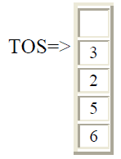
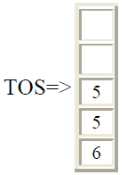
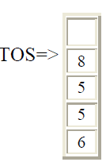
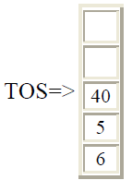
Example: 6 5 2 3 + 8 * + 3 + *
Push items 6 through 3
Next + is read (binary operator), pop 3 & 2, push their sum 5 onto the stack:
Next 8 is pushed
Next item is * :
6 5 2 3 + 8 * + 3 + *
(8, 5 popped, 40 pushed)

Slide 25
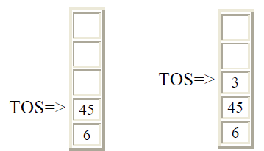
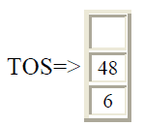
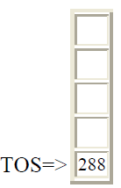
6 5 2 3 + 8 * + 3 + *
Next the operator + followed by 3:
Next is + , pop 3 & 45 and push 45+3=48
Next is *, pop 48 & 6 ,and push 6*48=288
(40, 5 popped, 45 pushed, 3 pushed)

Slide 26
Converting Infix to Postfix
Convert A + B * C to postfix form:
A + B * C Infix Form
A + (B * C) Parenthesized expression
A + (B C *) Convert the multiplication
A (B C *) + Convert the addition
A B C * + Postfix form
Rules:
Parenthesize from left to light, higher precedence operators parenthesized first
The sub-expression (part of expression), which has been converted into postfix, is treated as single operand
Once the expression is converted to postfix form, remove the parenthesis

Slide 27
Example: A + [ (B + C) + (D + E) * F ] / G
A + { [ (BC +) + (DE +) * F ] / G}
A + { [ (BC +) + (DE + F *] / G}
A + { [ (BC + (DE + F * +] / G}
A + [ BC + DE + F *+ G / ]
ABC + DE + F * + G / +

Slide 28
Reading Assignment
An algorithm exists that converts infix to postfix using stack
Implementing recursion using stack (text: section 4.2.4)

